Slide 1

Be a shepherd for your data, Protect- and prevent data leaks
It's that simple!
04.07.2023
Pim Jacobs
Dutch Cloud Meetup

Slide 2
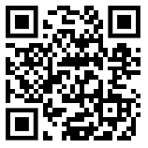
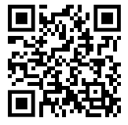




About me
Pim Jacobs
Principal Consultant @ InSpark
Microsoft MVP Security
Let’s connect!
Blog: https://www.identity-man.eu/
Mail: pim.jacobs@inspark.nl

Slide 3
Agenda for today
Introduction of Defender for Cloud Apps
Key features and importance as organizations are licensed but aren’t using DfCA😐
Retrieving data by enabling integration
Learn how to retrieve data, enable integrations and work with the gathered data
Defender for Cloud App Policies
Learn what policies are available and how to enable or create policies yourself
Considerations & next steps
Tips & tricks to get you kick started
Questions
…and hopefully I have some answers 😉

Slide 4
Introduction of Defender for Cloud Apps

Slide 5

What is Defender for Cloud Apps
Gatekeeper for broker access
Discovers Shadow IT
Control Access
Prevents and protects against data leaks
Discovers security & compliance gaps
Helps IT to find the right balance

Slide 6

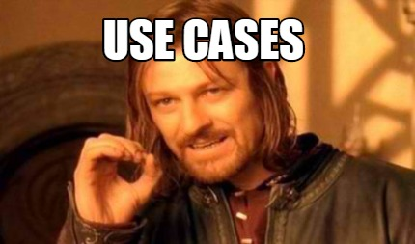
Defender for Cloud Apps use-cases
Getting Insights
Know which apps are used in your organization and by whom
Helps to make decisions
Are these apps allowed?
Improving your protection level
Conditional Access is great, but it can be better and even more granular
Use of Dropbox within your organization
Use of over privileged applications
Are these apps complaint?
Setup Single Sign-on for protection and new functionality
Restrict cut/copy & paste from browser sessions
Getting alerts
Mass downloads or worse mass deletes
Stale externally shared files
And much more!

Slide 7

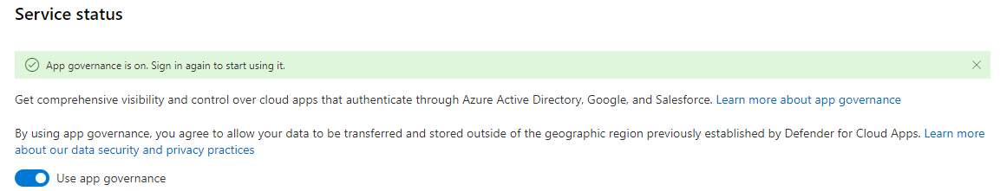
Defender for Cloud Apps - App Governance
App governance add-on has been added to the Defender for Cloud Apps Service since June 2023!
Provides a clear overview in your Apps (AAD, Google & Salesforce).
List down apps in ‘App Categories’
Fully integrates with Microsoft Defender 365 Incidents and Alerts
Comes with a predefined set of policies
Create policies for app use and permissions

Slide 8
Retrieving data by enabling integration

Slide 9
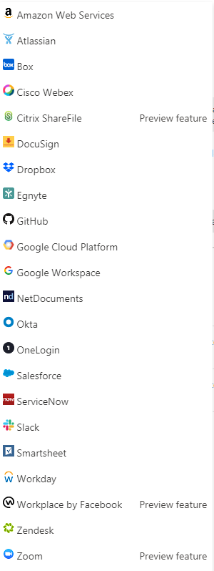
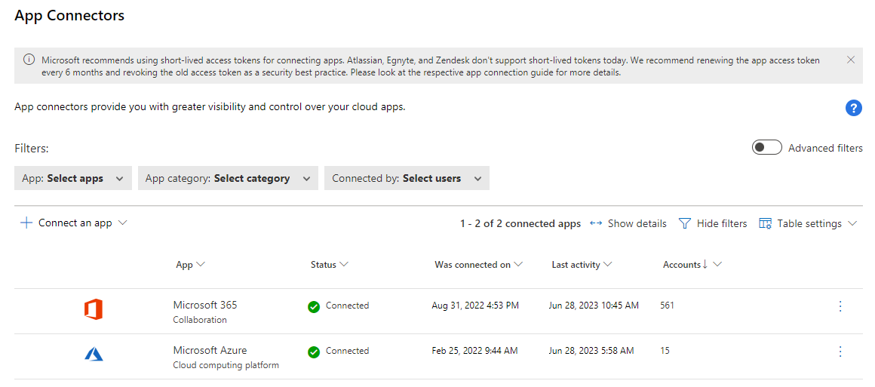
Getting Defender for Cloud Apps data

Slide 10
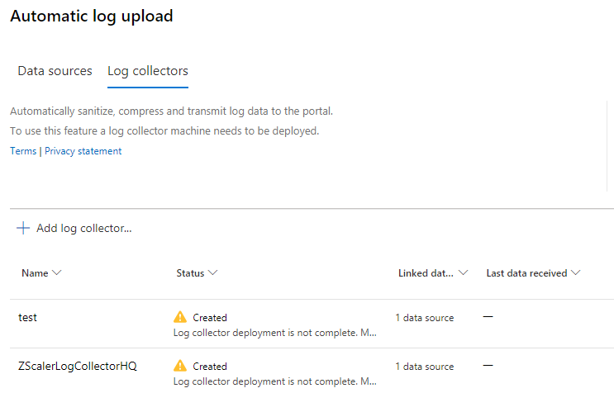
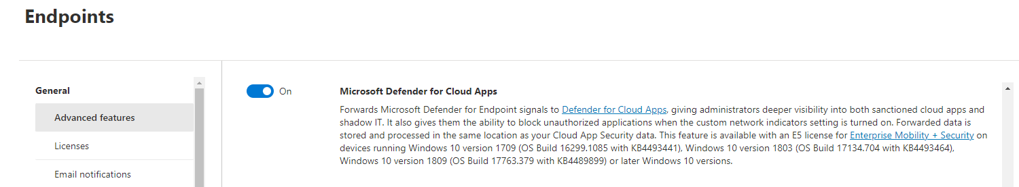
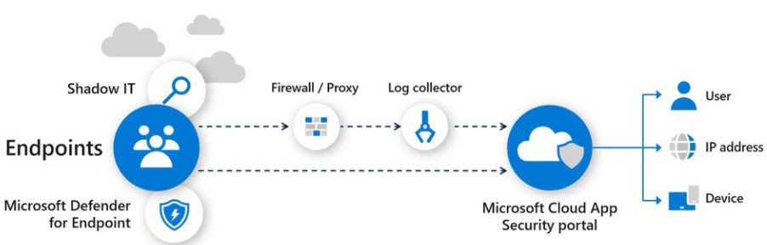
Getting Defender for Cloud Apps data
* Microsoft Defender for Cloud Apps + Defender for Endpoint P2

Slide 11
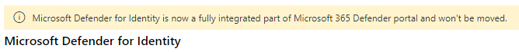
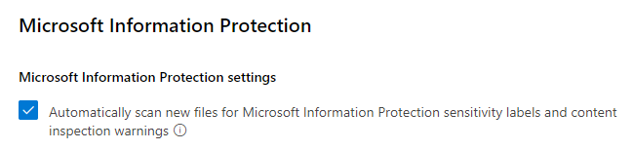

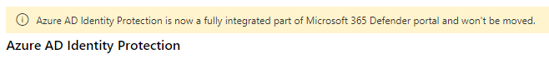
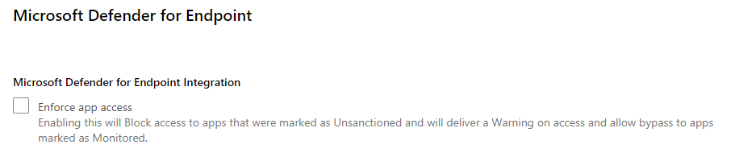
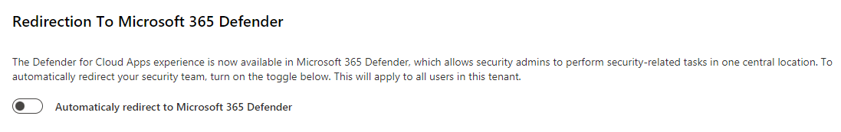
Enable Microsoft Integrations

Slide 12
DEMO

Slide 13
Defender for Cloud App Policies

Slide 14
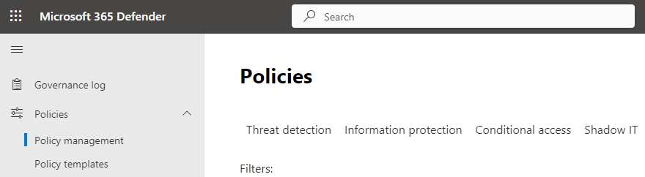
Available policy types
Threat detection
Information Protection
File policies
Conditional Access
Shadow IT
Access policies
Session policies
App discovery policy
Cloud discover anomaly detection policy
Activity policies
OAuth app policies (via App Governance)

Slide 15
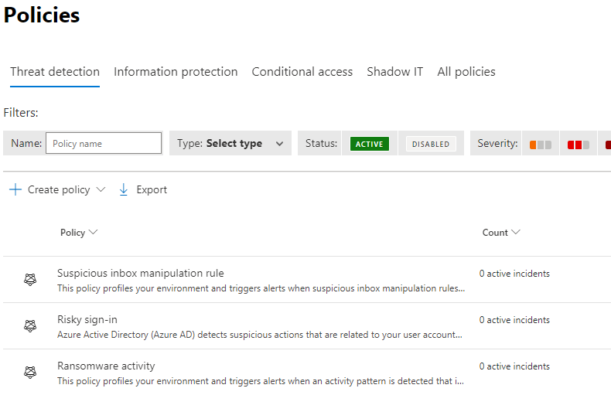
DfCA Threat detection policies
We can monitor activities with DfCA
Threat detection policies!
From the field examples:
Mass downloads
Mass deletes
Malicious OAuth app consent
Suspicious email deletion activity
Potential ransomware activity

Slide 16
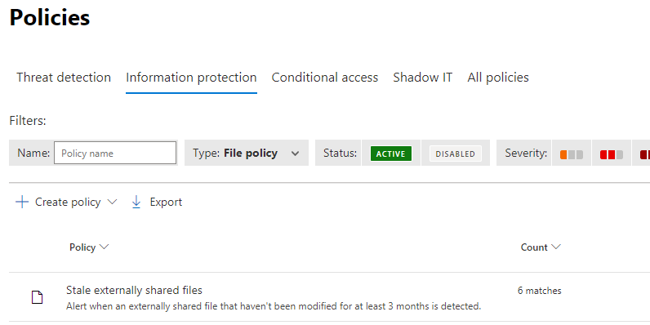
DfCA Information Protection policies
We can monitor activity on files within your tenant with DfCA Information Protection policies!
From the field examples:
Confidential files shared with personal email addresses
Stale externally shared files
File shared with unauthorized domain(s)

Slide 17
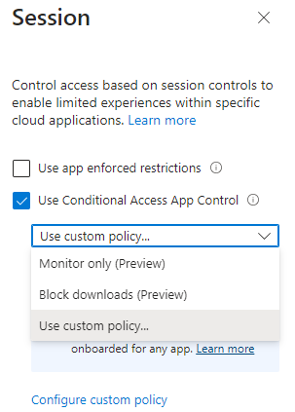
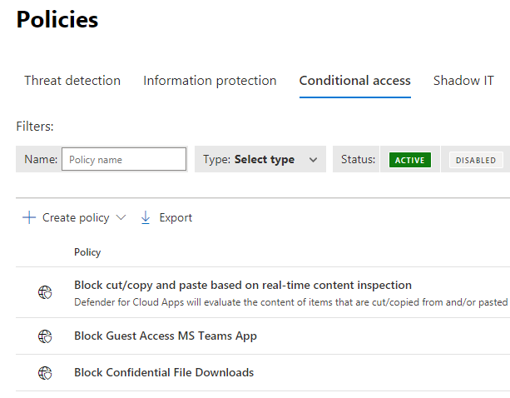
DfCA Conditional Access policies
Available Conditional Access Session Controls:
Monitor only
Block downloads
Use a custom policy

Slide 18
DfCA Conditional Access policies
We can monitor access and sessions with DfCA Conditional Access policies!
From the field examples:
Access is used for mobile and desktop apps
Session is used for browser-based apps
Apps must support Conditional Access App Control
Restrict cut/copy/paste for users without a managed device
Block downloads on noncompliant devices
Limit restrictions for guest users

Slide 19
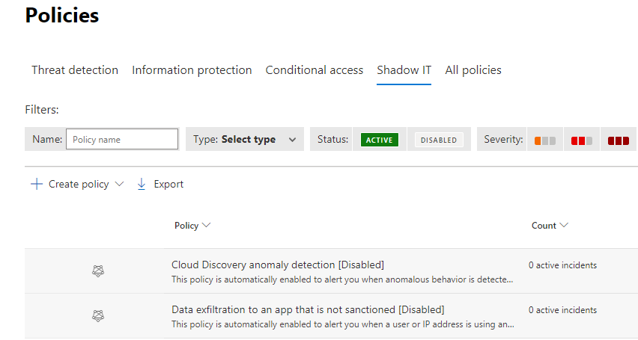
DfCA Shadow IT policies
We can monitor anomalies and newly discovered apps with DfCA Shadow IT policies?
From the field examples:
New risky app
New cloud storage app
New collaboration app
New high upload volume app

Slide 20
DEMO

Slide 21
Tips & Tricks
And start being a shepherd for your data!

Slide 22
How & where to start tomorrow?
Start enabling integrations with Defender for Cloud Apps
Enable App Governance
Review high privileged and over privileged app permissions
Review pre-defined policies and setup alerts where needed
Or create your own custom policies
If sensitivity labels are in need for policies make sure those are available for use
Create your Access and Session policies within Defender for Cloud Apps
For end users AND Guest users!
Fine tune with cross-tenant access trust to allow compliance from home tenant for trusted orgs.
Start with a small pilot group which you’re targeting in Conditional Access.
Fine tune where this is needed and required
Roll-out to production

Slide 23
Questions?
And hopefully I have some answers ;-)

Slide 24


Thank you!
Pim Jacobs
pim.jacobs@inspark.nl

